Slide 1

Restormer: Efficient Transformer for High-Resolution Image Restoration
Author :
Syed Waqas Zamir, Aditya Arora, Salman Khan, Munawar Hayat
Advisor : Tsung-Jung Liu
Student : Chi-Mao Fan

Slide 2

Outline
01
Introduction
02
Related Work
03
Method
04
Experiment
05
Conclusion

Slide 3
01
Introduction
02
Related Work
03
Method
04
Experiment
05
Conclusion

Slide 4
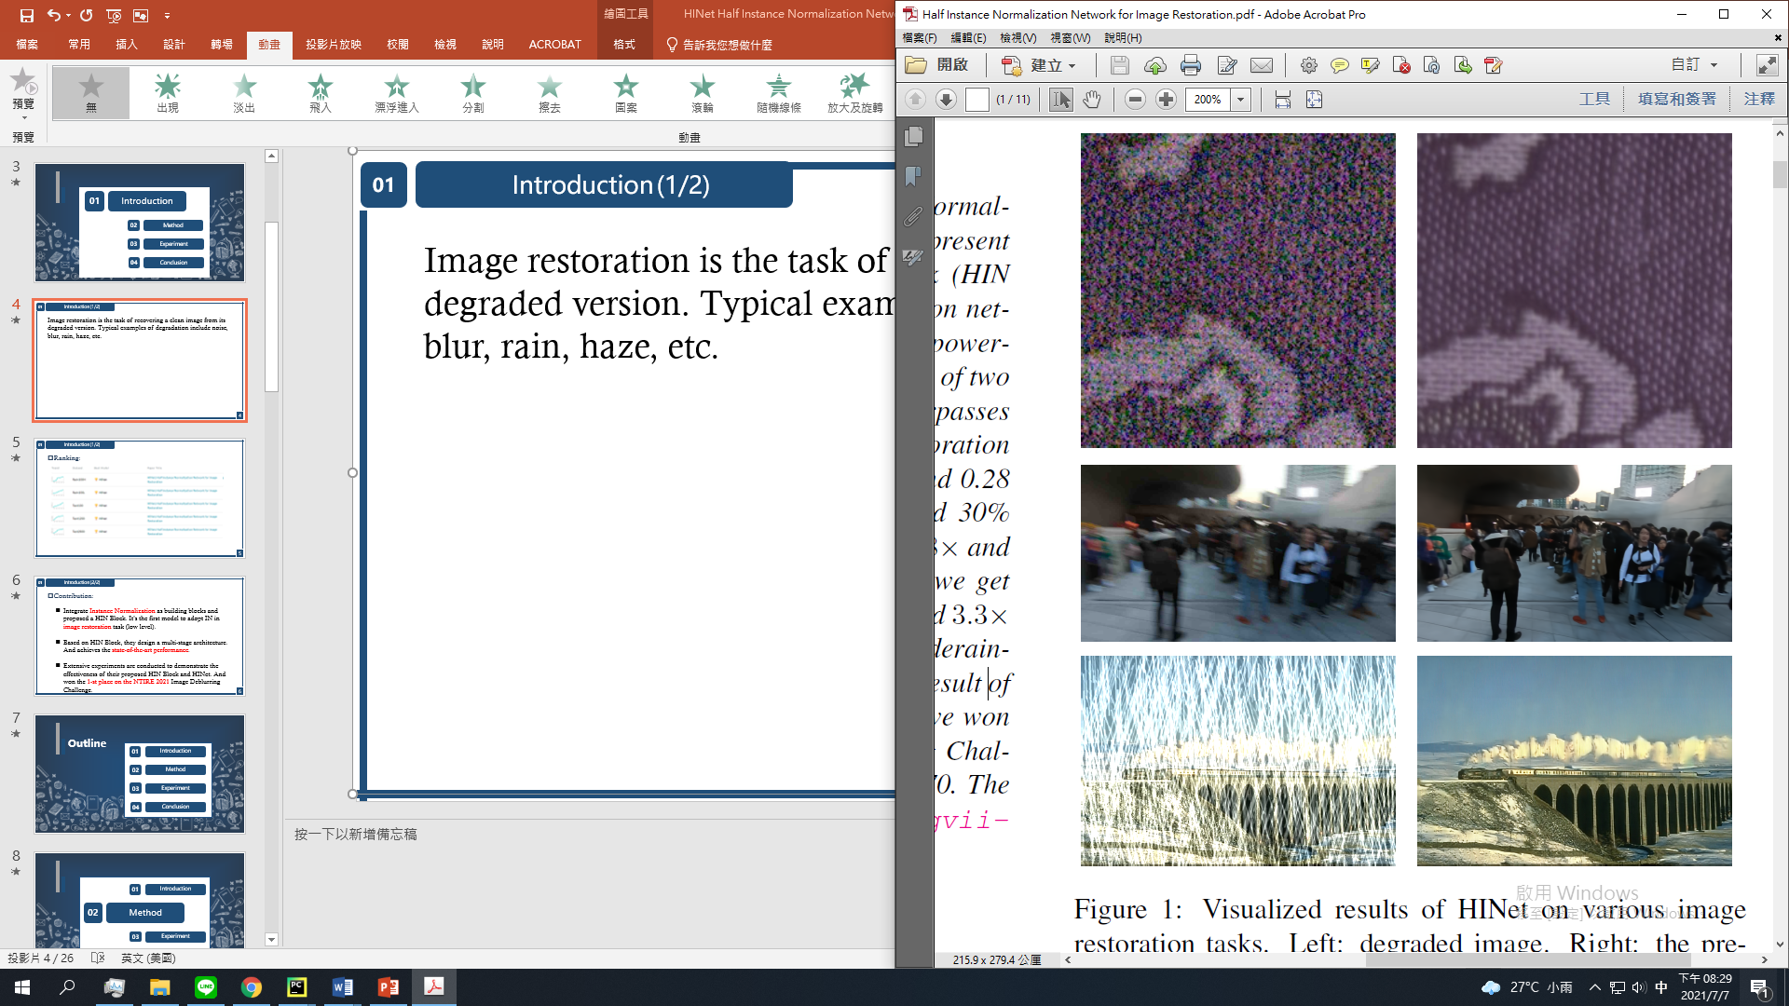
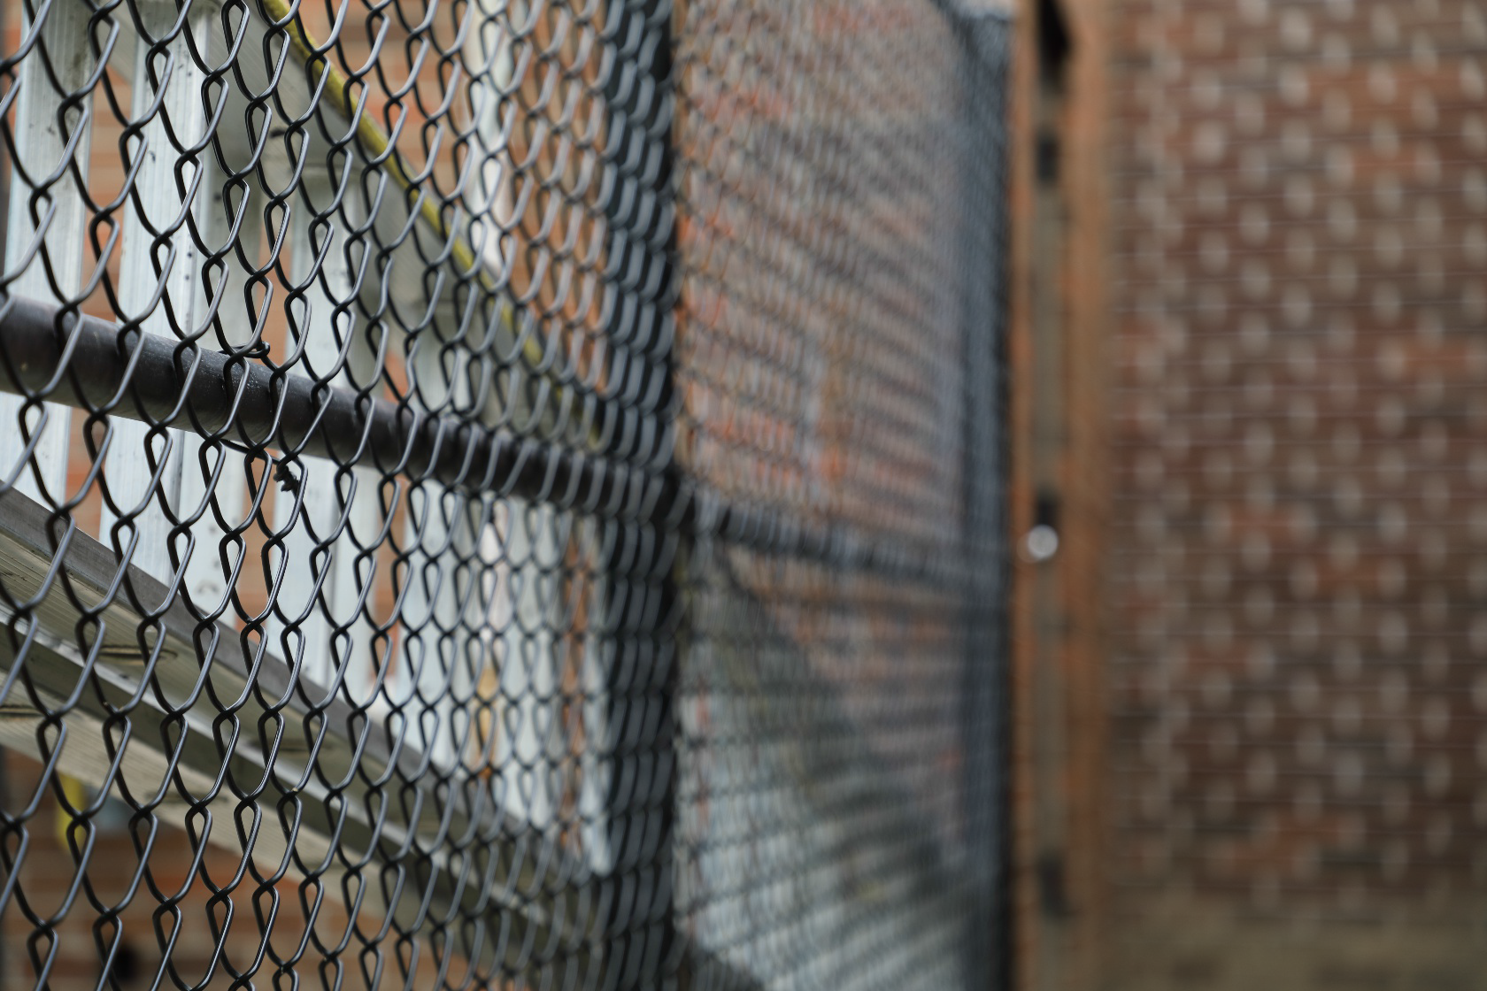
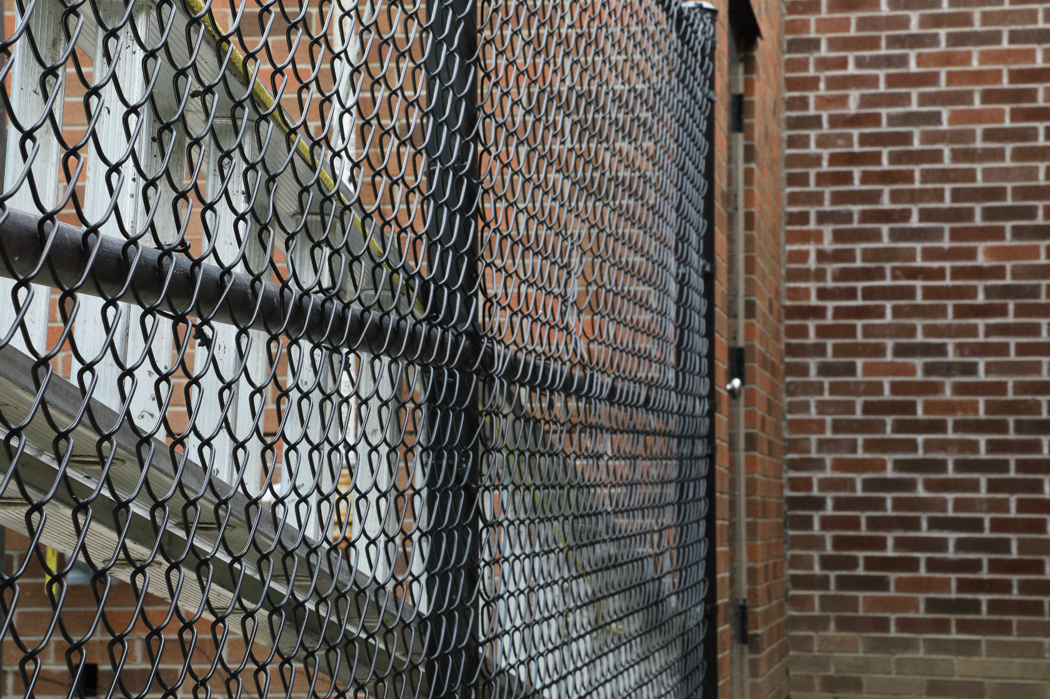
01
Introduction
(1/3)
Image restoration is the task of recovering a clean image from its degraded version. Some examples of degradation such as Image Deblurring, Deraining, Denoising, etc.
4

Slide 5
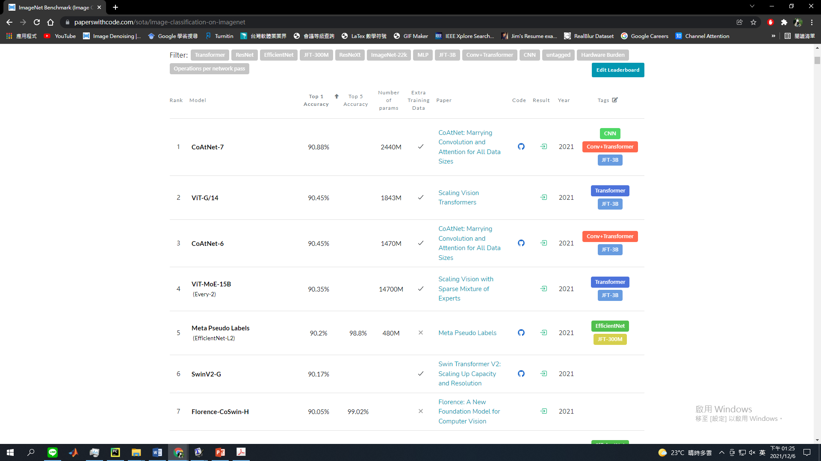
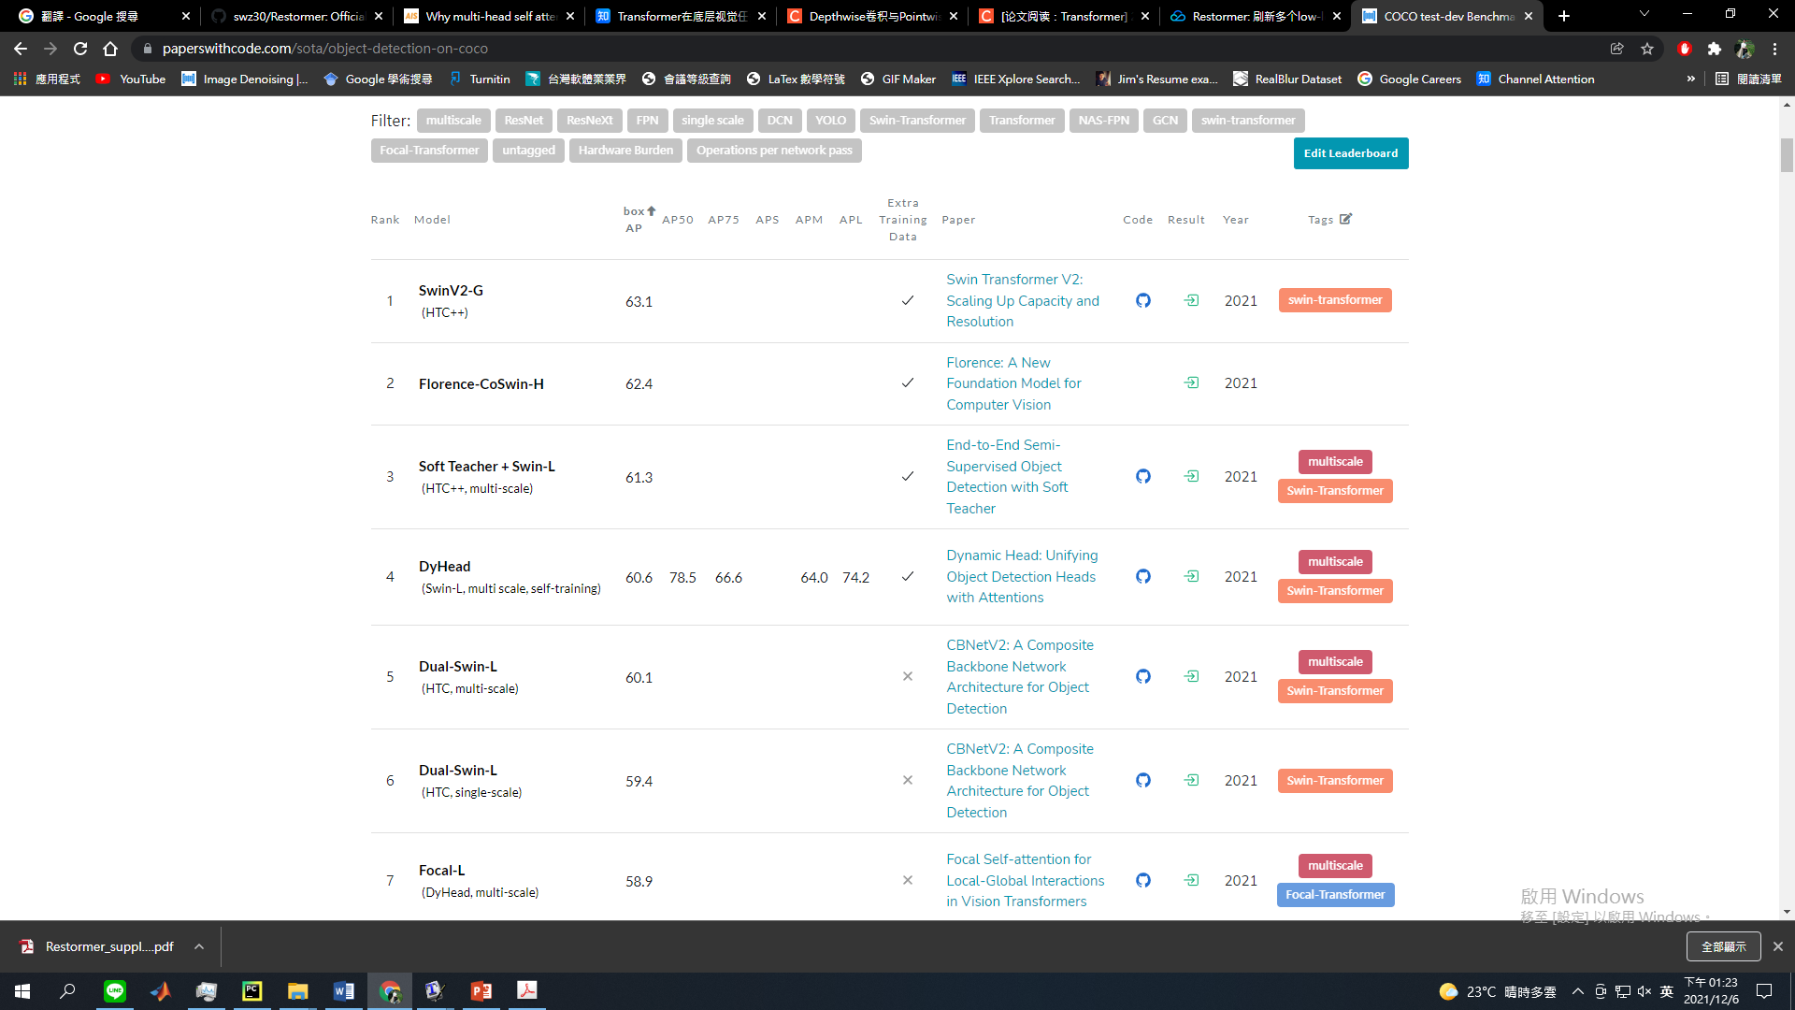

01
Introduction
(2/3)
Transformer
5

Slide 6
01
Introduction
(3/3)
Contribution
Propose a multi-scale local-global representation learning for image restoration model Restormer.
Propose a Multi-Dconv head transposed attention (MDTA) module which is capable of aggregating local and non-local pixel interactions.
A new Gated-Dconv feed-forward network (GDFN) that performs controlled feature transformation.
Propose a progressive learning which behaves in a similar to curriculum learning.
6

Slide 7
Outline
01
Introduction
02
Related Work
03
Method
04
Experiment
05
Conclusion

Slide 8
01
Introduction
02
Related Work
03
Method
04
Experiment
05
Conclusion

Slide 9
02
Related Work
(1/8)
Related Work
NLP (Neural Language Processing)
Self-Attention
Multi-head Self-Attention (MSA)
Transformer
Transformer on CV
Swin Transformer
Short Summary
9

Slide 10
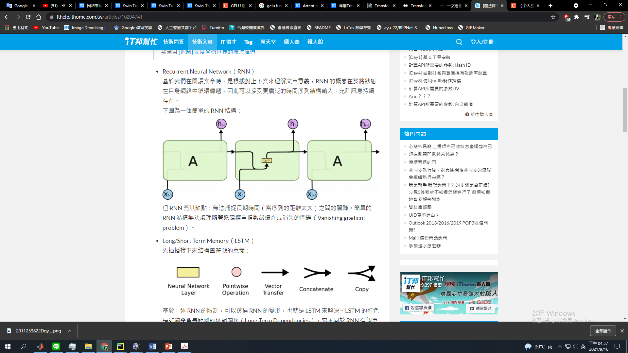
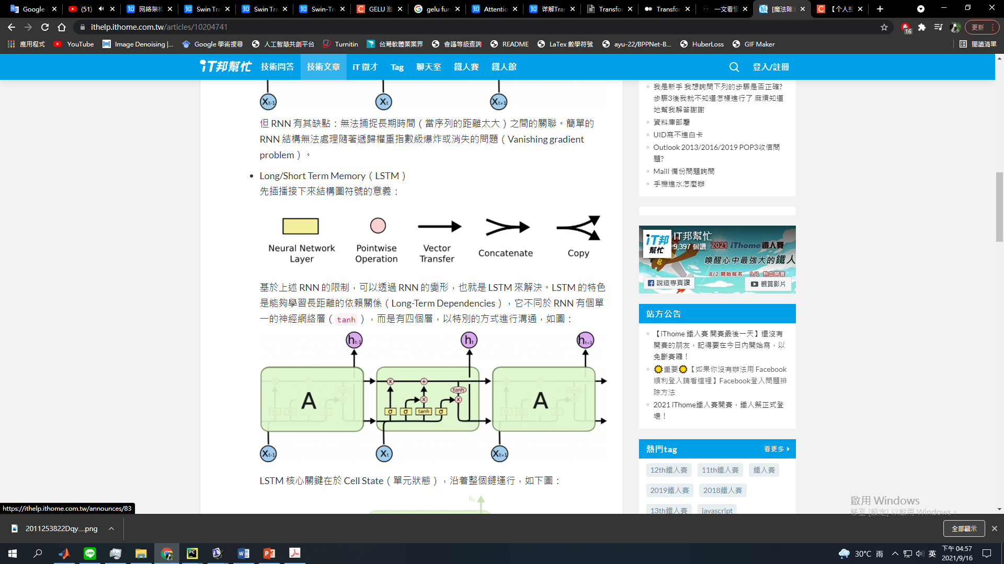
02
Related Work
(2/8)
1. NLP (Neural Language Processing)
RNN
Seq2Seq (Encoder-decoder)
Translation example:
“I arrived at the bank after crossing the river”
Main shortage of RNN and LSTM:
Global information may loss.
Can’t parallel process.
LSTM
10
Notes:
Difficult to parallel process

Slide 11
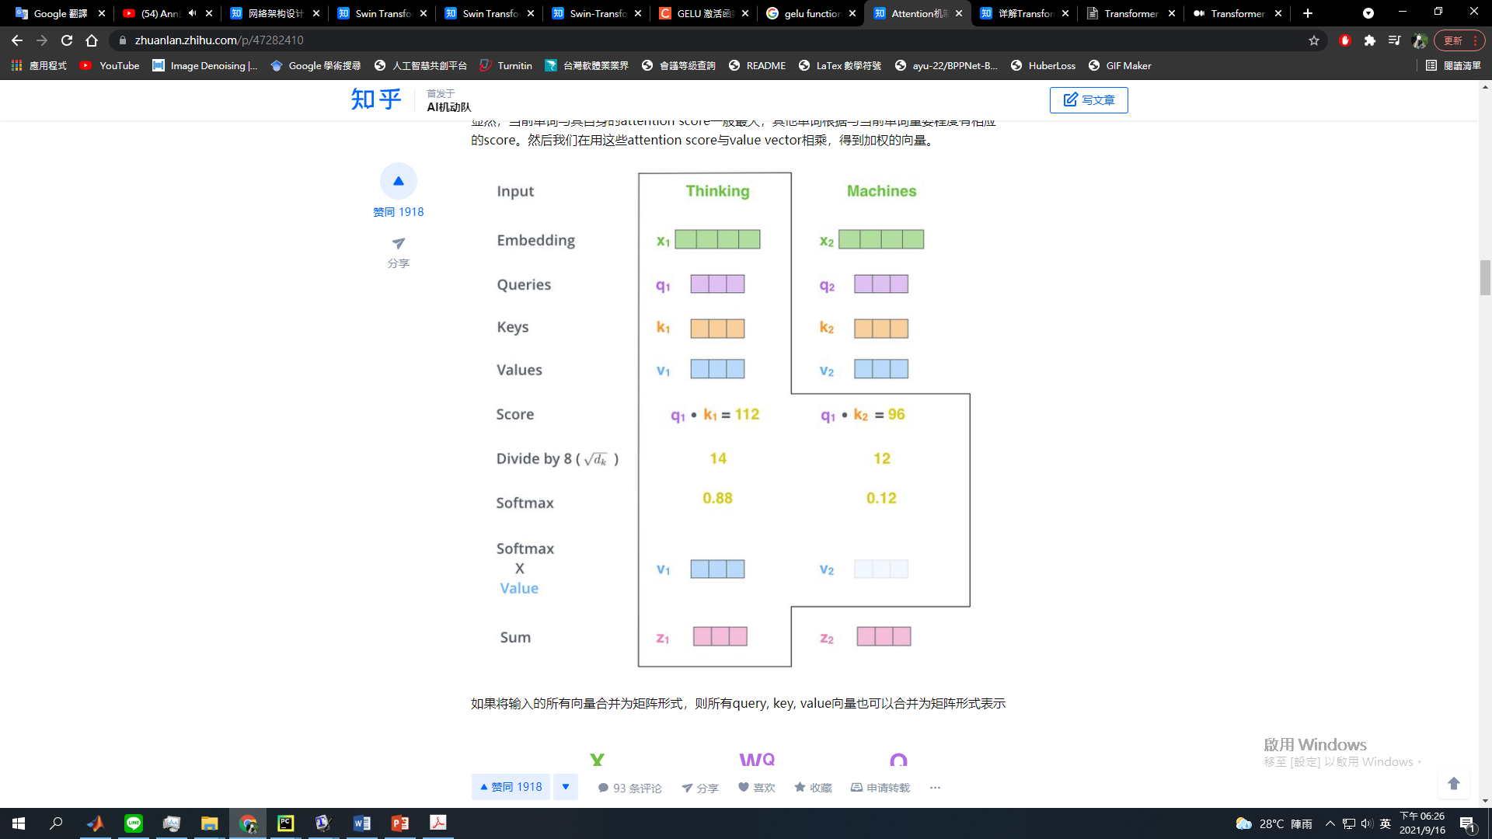
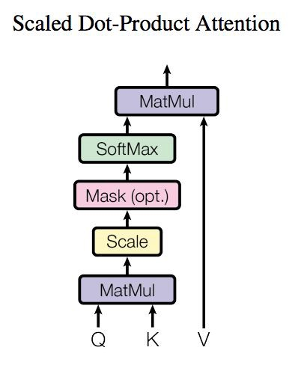
02
Related Work
(3/8)
2. Self-Attention
11
Notes:
Attention機制上世紀 (Dropout BN)
(2017 google)

Slide 12
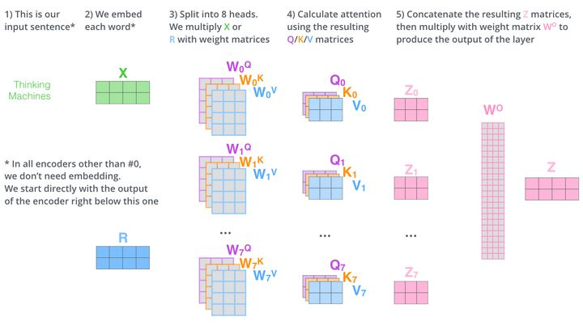
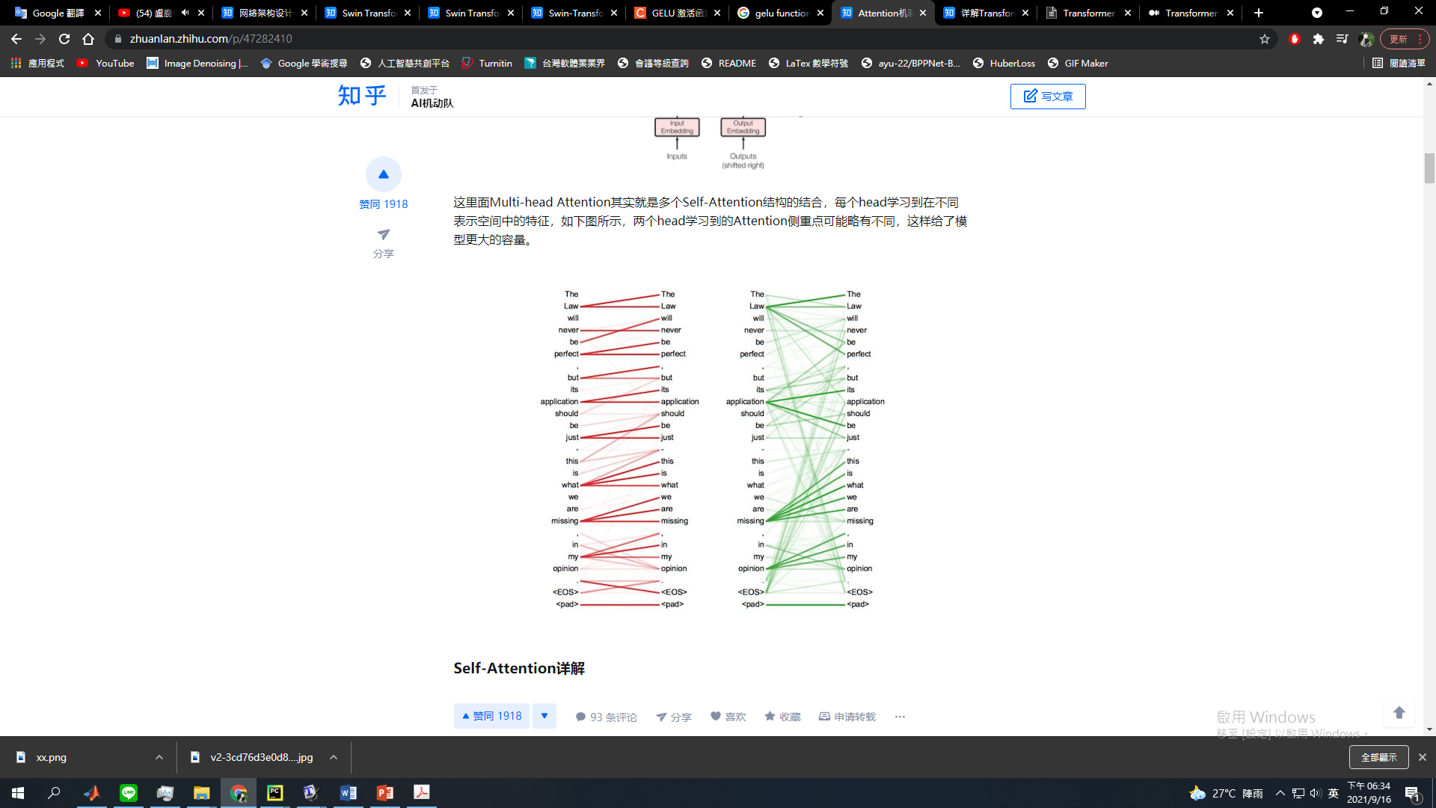
02
Related Work
(4/8)
3. Multi-Head Self-Attention (MSA)
Ensemble
12

Slide 13
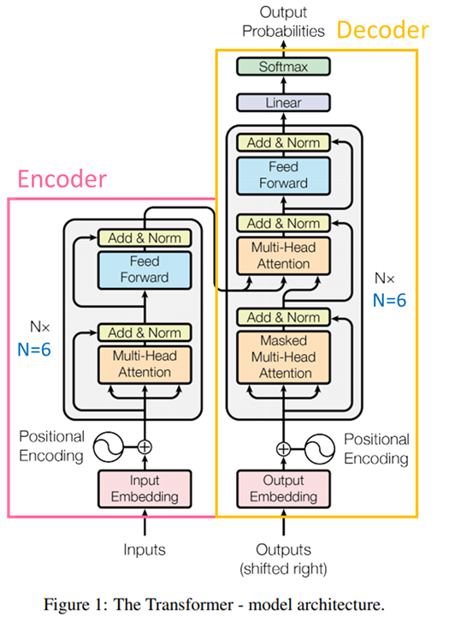
02
Related Work
(5/8)
4. Transformer on NLP (Multi-head Self-Attention)
Encoder (MSA + LN + FFN + LN)
Decoder
Good at NLP, but not really good at
image processing.
13

Slide 14
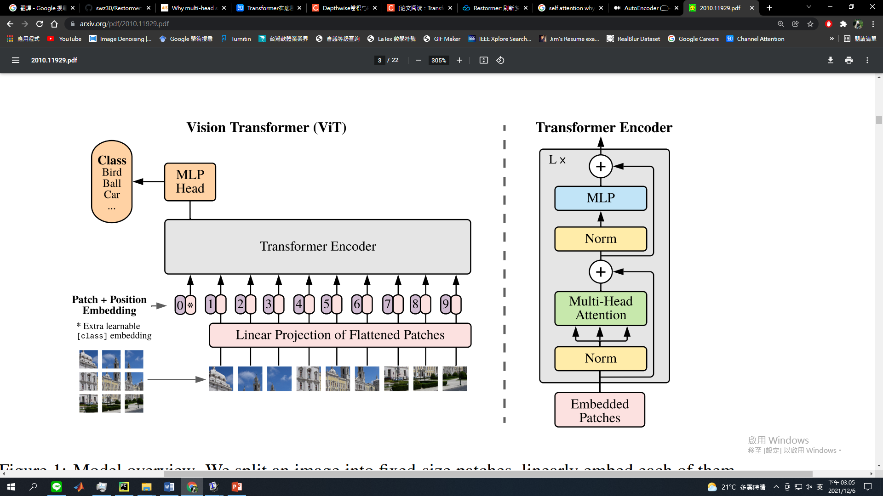
02
Related Work
(6/8)
5. Transformer on CV: Vision Transformer (ViT) -- 2020
First paper using Transformer on CV
Patch partition:
256x256:
64 patches with the size of
32x32
High-level vision task
image segmentation
image classification
object detection
14
Notes:
W → W^2
WH → WHWH

Slide 15
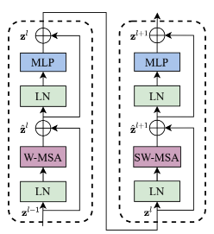
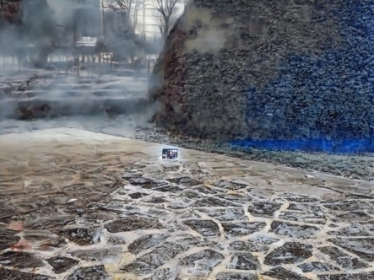
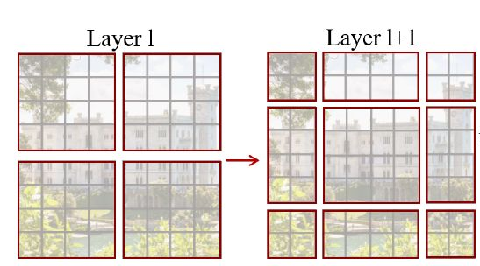
02
Related Work
(7/8)
6. Swin Transformer (Shifted Window Transformer)
Hierarchical Vision Transformer using Shifted Windows – 2021.5.25
Optimize Transformer to achieve the better performance.
Patch problem: different patch partition between two layers -- cyclic shift
Have the ability to replace Convolution
15
Notes:
5月 286 citation
Object detection, instance segmentation

Slide 16
02
Related Work
(8/8)
7. Short Summary
1985
2014
2020
2021.6
LSTM
Transformer
Swin Transformer
Restormer
RNN
RNN +
Self-attention
ViT
SwinIR
Now
1997
2017
2021.5
2021.11
16
Notes:
Learning internal representations by error propagation recurrent networks
LONG SHORT-TERM MEMORY 1 INTRODUCTION LSTM

Slide 17
Outline
01
Introduction
02
Related Work
03
Method
04
Experiment
05
Conclusion

Slide 18
01
Introduction
02
Related Work
03
Method
04
Experiment
05
Conclusion

Slide 19
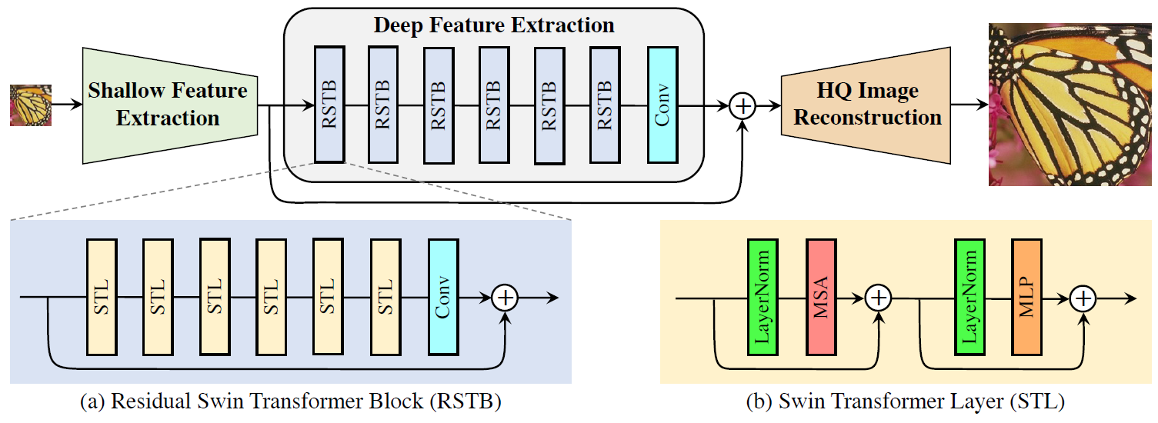
03
Method
(1/4)
SwinIR architecture
19
Notes:
4 6 6 8

Slide 20
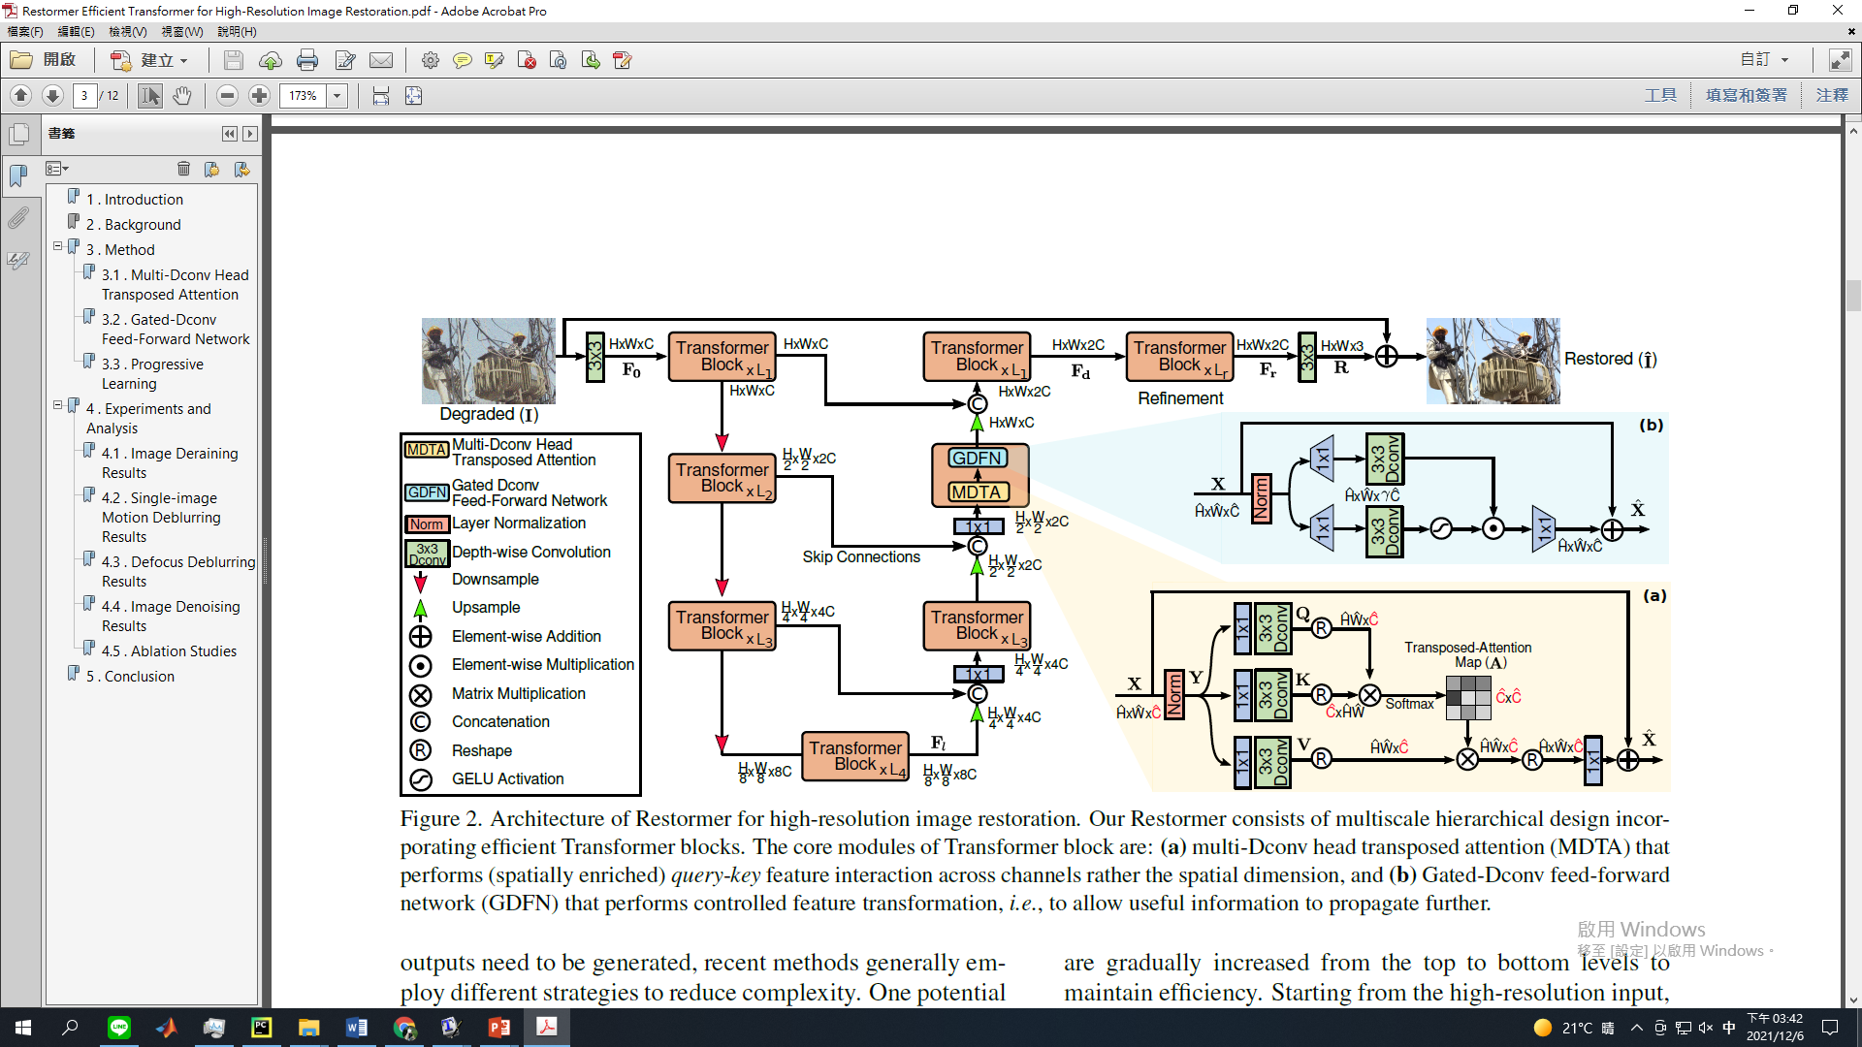
03
Method
(2/4)
Restormer architecture
20
Notes:
4 6 6 8

Slide 21
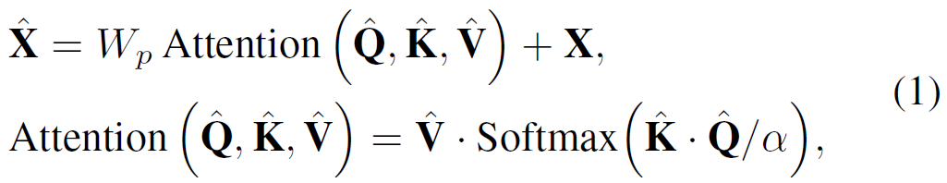
03
Method
(3/4)
Multi-Dconv Head Transposed Attention (MDTA)
21

Slide 22
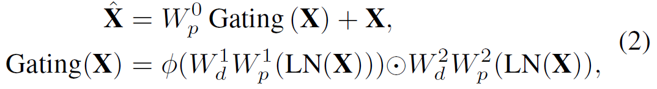
03
Method
(4/4)
Gated-Dconv Feed-Forward Network (GDFN)
Gating mechanism
Depthwise convolution
(Xception)
22
Notes:
Gaussian Error Linear Unit

Slide 23
Outline
01
Introduction
02
Related Work
03
Method
04
Experiment
05
Conclusion

Slide 24
01
Introduction
02
Related Work
03
Method
04
Experiment
05
Conclusion

Slide 25
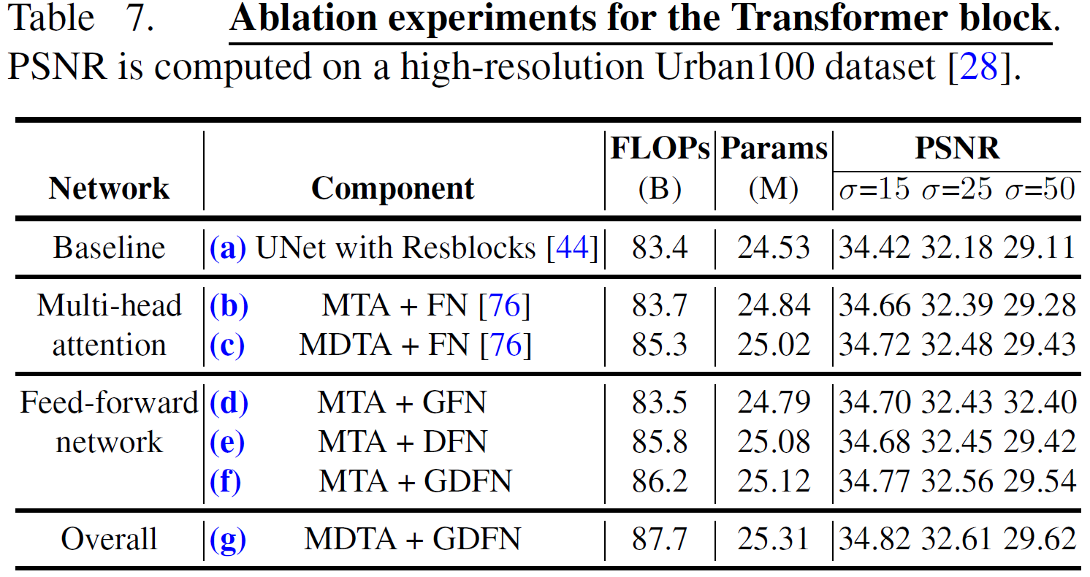
04
Experiment
(1/8)
Ablation Studies
25

Slide 26
04
Experiment
(2/8)
Experiments
Image Deraining
Image Deblurring
Motion Blur
Defocus Blur
Denoising
Grayscale Gaussian Noise
Color Gaussian Noise
Real World Noise
26

Slide 27
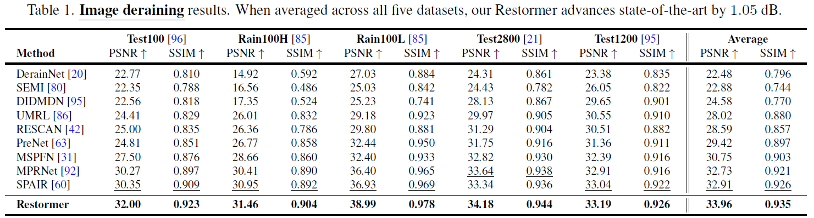
04
Experiment
(3/8)
Performance of Deraining
27

Slide 28
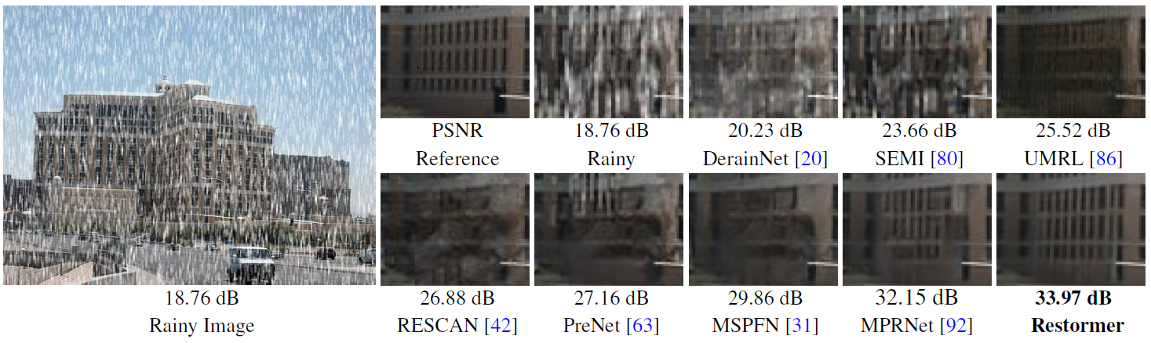
04
Experiment
(4/8)
Visual Result of Deraining
28

Slide 29
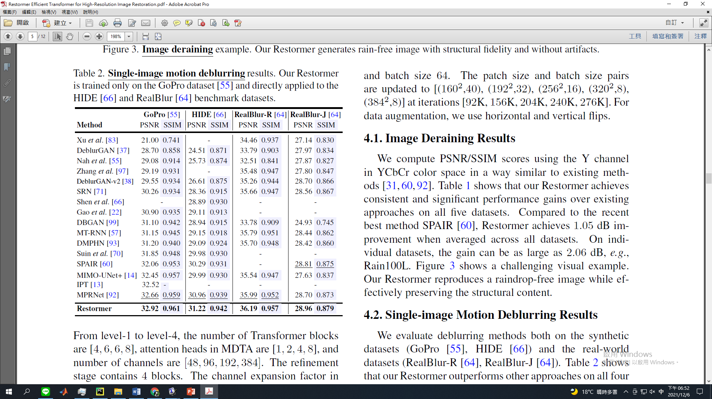
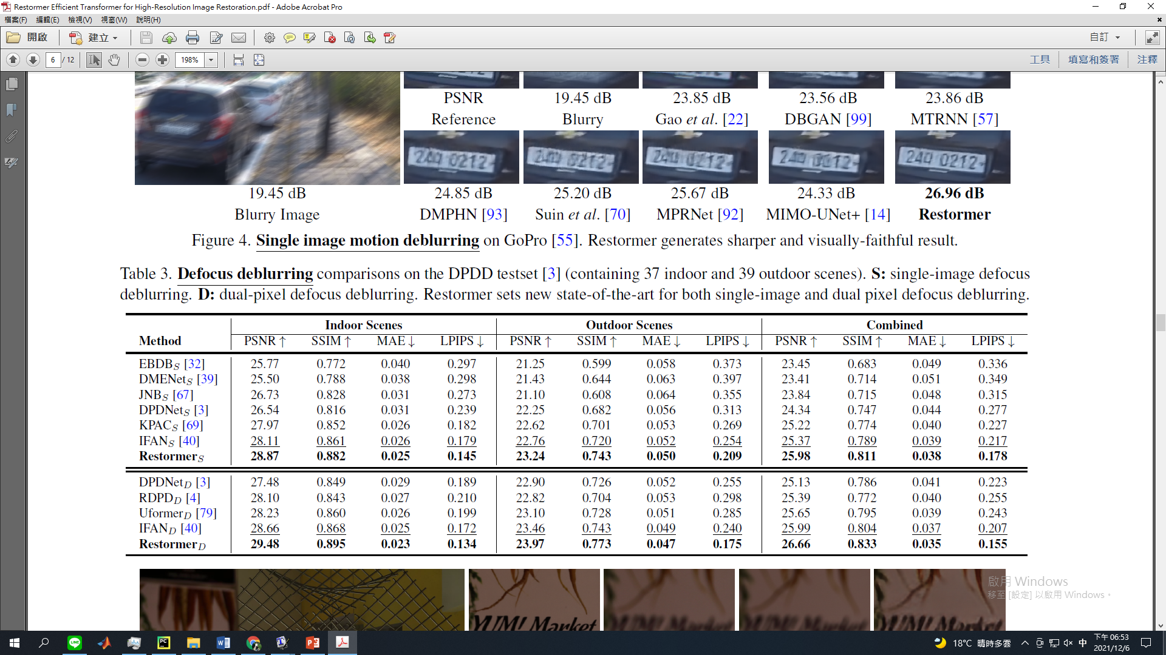
04
Experiment
(5/8)
Performance of Deblurring
29
Notes:
learned-perceptual-image-patch-similarity

Slide 30
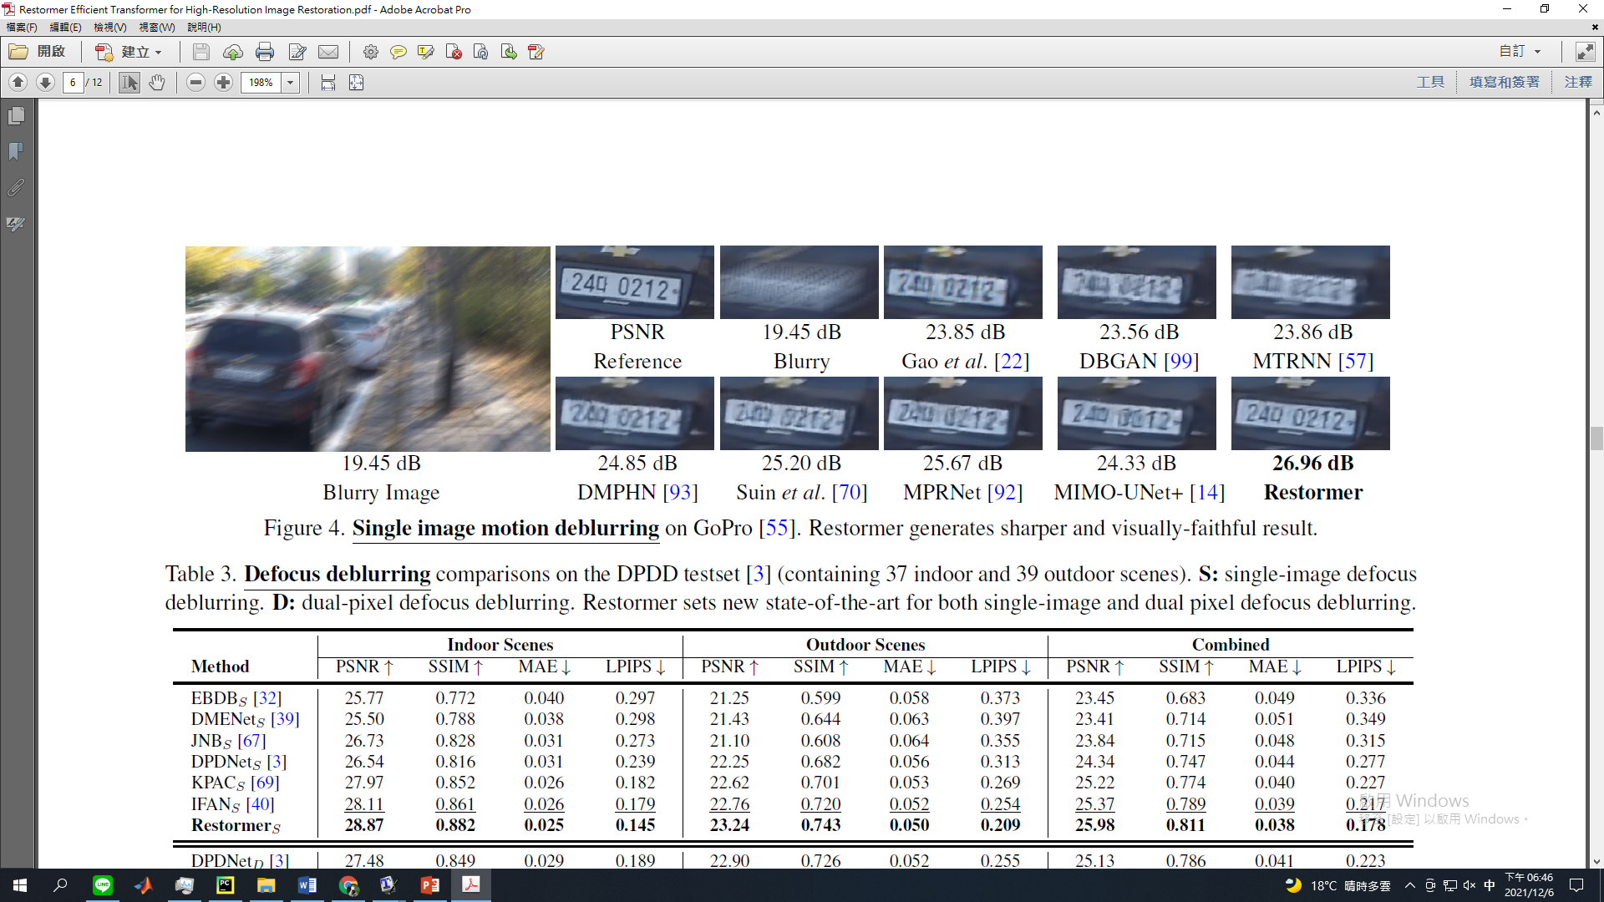
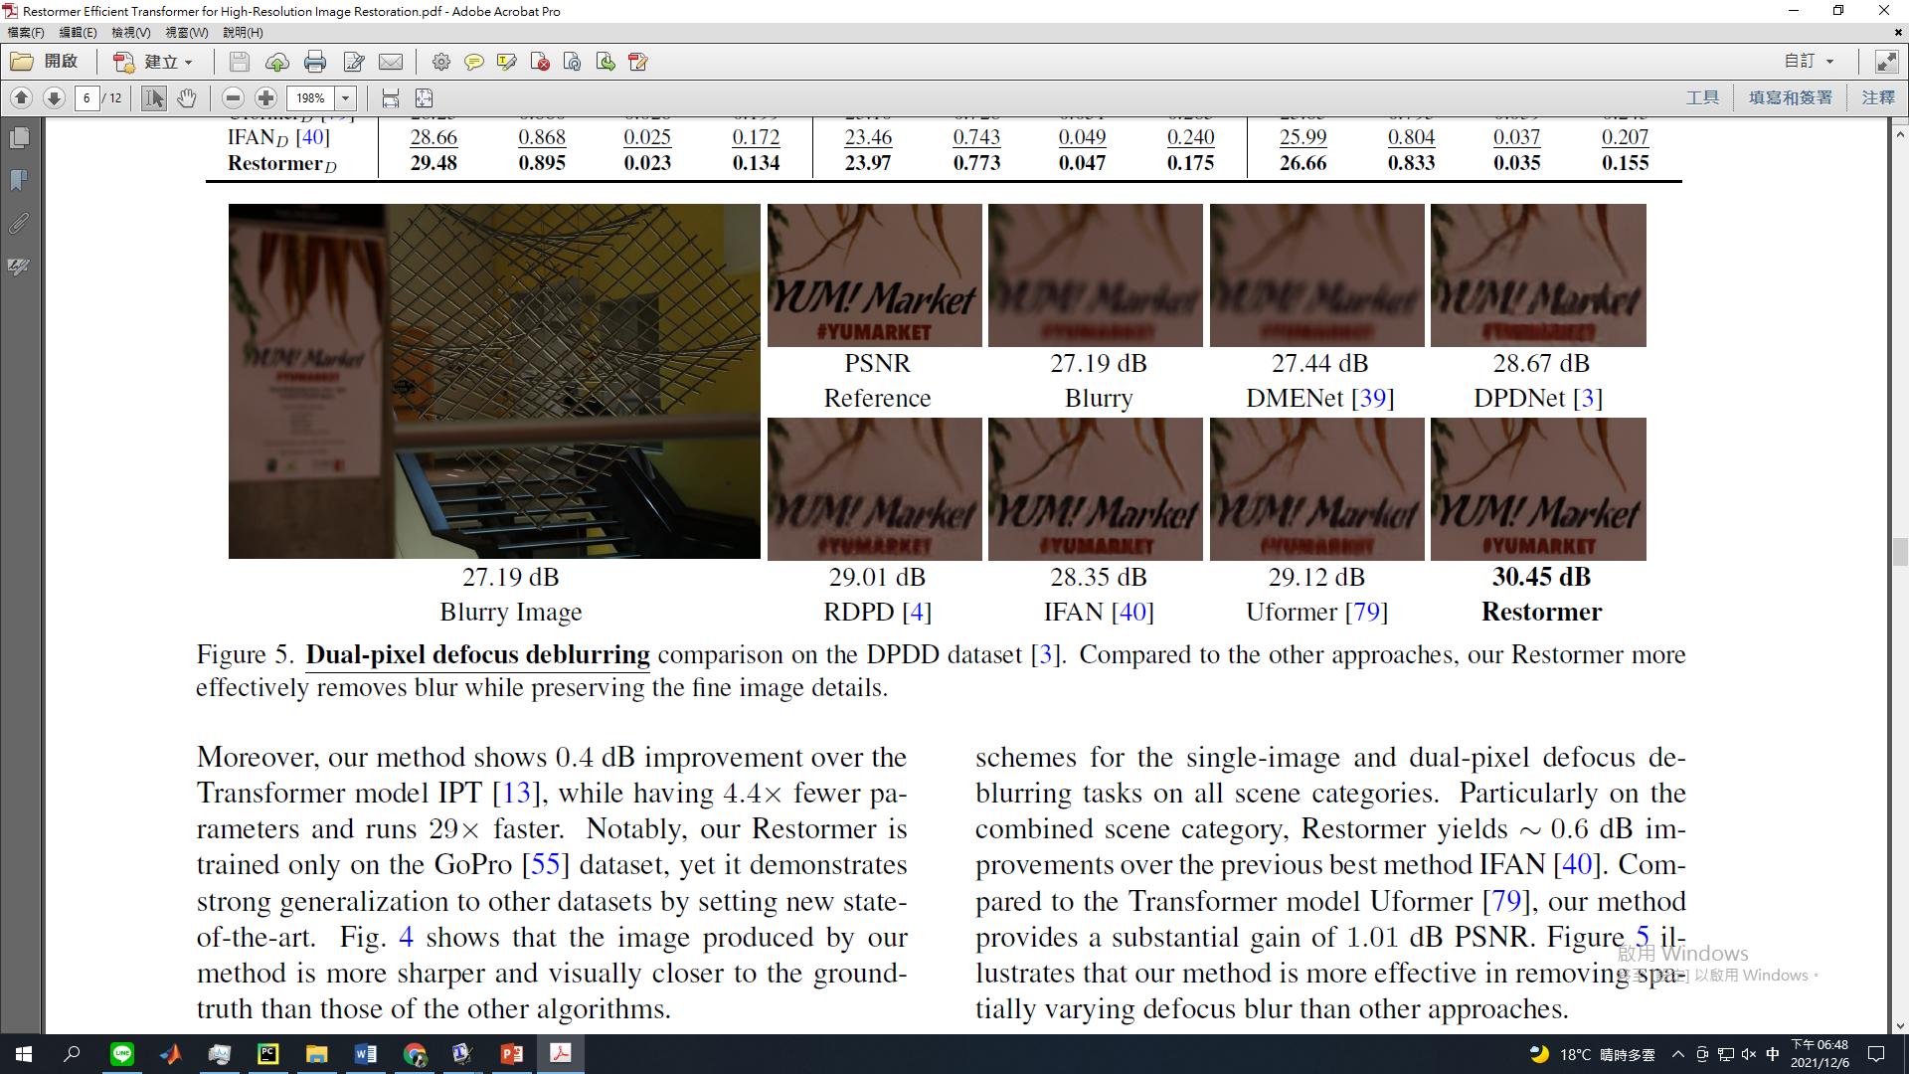
04
Experiment
(6/8)
Visual Result of Deblurring
30

Slide 31
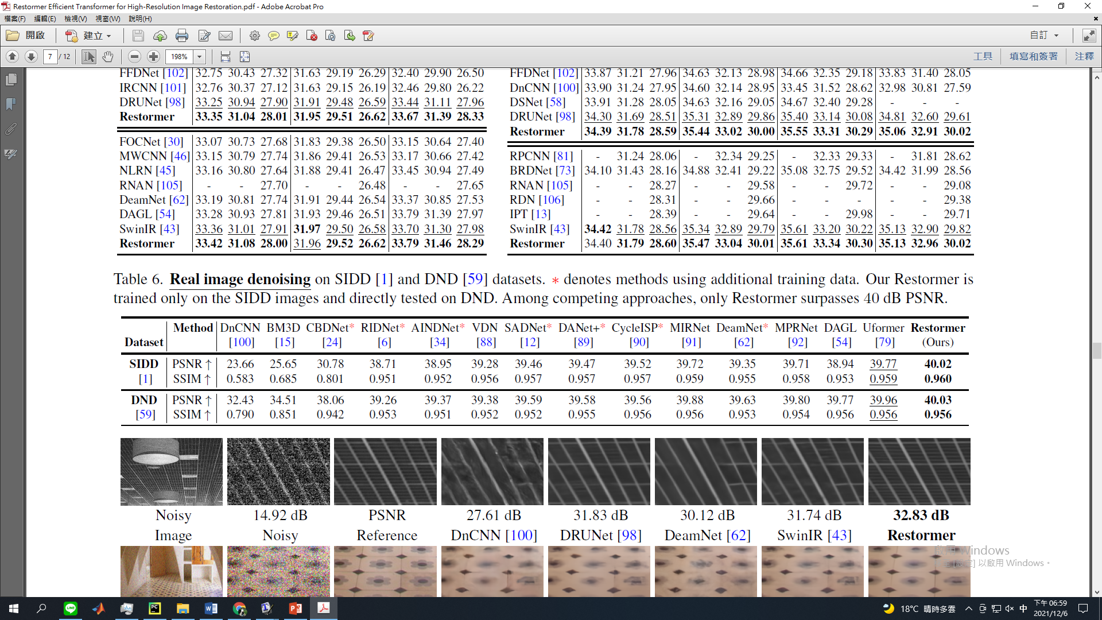
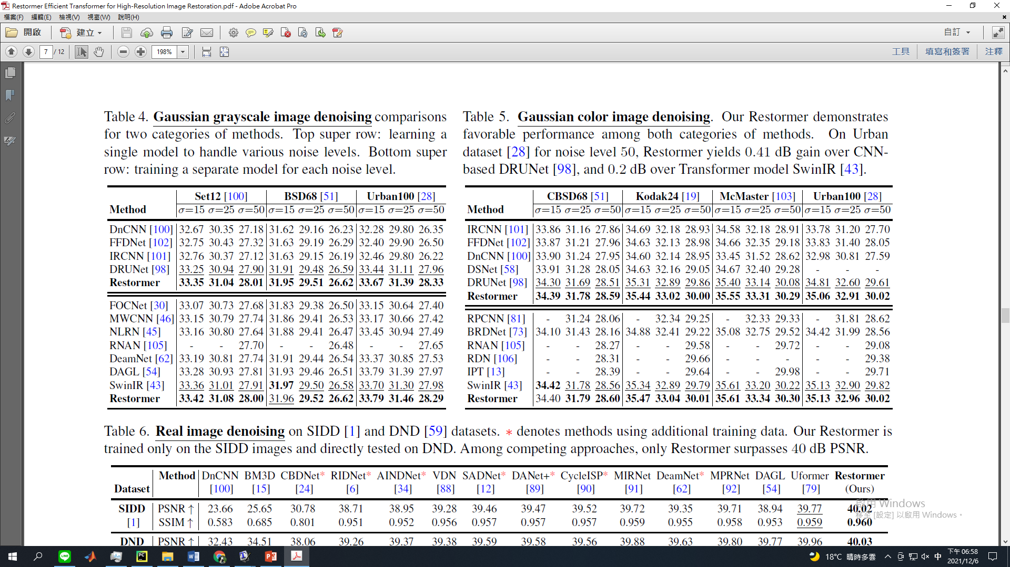
04
Experiment
(7/8)
Performance of Denoising
31
Notes:
learned-perceptual-image-patch-similarity

Slide 32
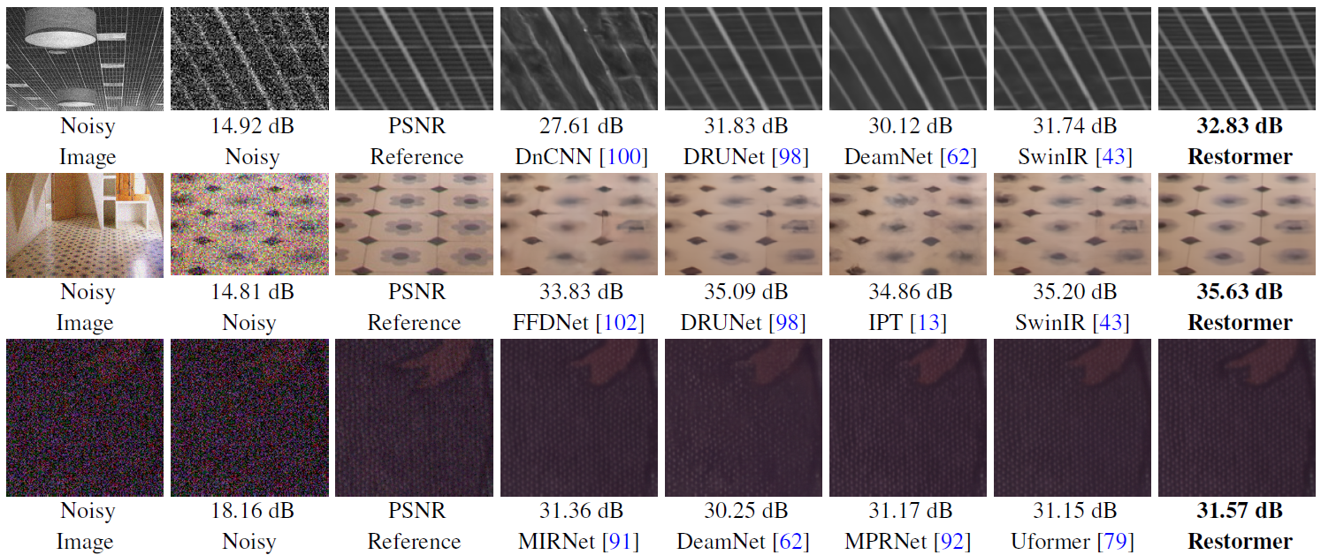
04
Experiment
(8/8)
Visual Result of Denoising
32

Slide 33
Outline
01
Introduction
02
Related Work
03
Method
04
Experiment
05
Conclusion

Slide 34
01
Introduction
02
Related Work
03
Method
04
Experiment
05
Conclusion

Slide 35

05
Conclusion
(1/1)
Conclusion
Propose a multi-scale local-global representation learning for image restoration model Restormer.
Propose a Multi-Dconv head transposed attention (MDTA) module which is capable of aggregating local and non-local pixel interactions.
A new Gated-Dconv feed-forward network (GDFN) that performs controlled feature transformation.
State-of-the-art performance on 16 datasets for 4 different restoration tasks.
35

Slide 36

Thanks for Listening
Student：Chi-Mao Fan
Date : 2021.12.10

